Slide 1

Facility Wide Resource Assessment

Slide 2
Objectives
Understand the intent of the regulation for facility wide resource assessment
Learn the elements of a compliant facility wide resource assessment
Describe the method to complete a hazard vulnerability assessment
Participate in the development of our facility specific resource assessment materials and plans

Slide 3
Purpose of Assessment
“The purpose of the assessment is to determine what resources are necessary to care for residents competently during both day-to-day operations and emergencies. Use this assessment to make decisions about your direct care staff needs, as well as your capabilities to provide services to the residents in your facility. Using a competency-based approach focuses on ensuring that each resident is provided care that allows the resident to maintain or attain their highest practicable physical, mental, and psychosocial well-being.”

Slide 4
Intent of FWRA
“The intent of the facility assessment is for the facility to evaluate its resident population and identify the resources needed to provide the necessary care and services the residents require.”

Slide 5

Regulation
The facility assessment must address or include the resident population:
Number of residents and capacity
Care required by resident population considering
Diseases and conditions
Physical and cognitive disabilities
Overall acuity
Other pertinent facts of your population
Notes:
This a new regulation for Phase 2 that is due November 28, 2017.

Slide 6

Regulation
The facility assessment must address or include:
Staff competencies necessary to provide level and types of care needed for your resident population
Physical environment, equipment, services and other physical plant considerations necessary to care for population
Any ethnic, cultural, or religious factors that may potentially affect the care provided by the facility including activities and nutrition services

Slide 7
Regulation
The facility assessment must address or include the facility’s resources:
All buildings and/or other physical structures and vehicles
Equipment (medical and non-medical)
Services provided such as therapy and pharmacy
All personnel including managers, staff (both employees and those providing services under contract), volunteers, as well as their education, training, and competencies related to resident care
Notes:
Address or include means that the facility assessment team must describe or include information for each section of the requirements

Slide 8
Regulation
The facility assessment must address or include the facility’s resources:
Contracts, memorandums of understanding, or other agreements with third parties to provide services or equipment to the facility during normal operations and in emergencies
Health Information Technology resources such as systems for electronically managing patient records and electronically sharing information with other organizations

Slide 9
Regulatory Guidance
May be similar to common business practices for strategic and capital budget planning
An organization’s process of defining its strategy or direction and making decisions on allocating resources to pursue its strategy
Must be conducted at the facility level, may include input from corporate organization

Slide 10
Regulatory Guidance
Will enable each nursing home to thoroughly assess the needs of its resident population and the required resources to provide care and services
A record for staff and management to understand the rationale for decisions made regarding staffing and other resources
May include the operating budget necessary to carry out facility functions

Slide 11

Recommended Participants
Participants should include at a minimum:
Administrator
Member of governing body
Medical Director
Director of Nursing
Others who should be involved as needed
Environmental Services / Plant Operations
Dietary Manager
Director of Therapy Services
Direct Care Staff
Providers are strongly encouraged to seek input from residents and representatives (could include resident or family council)

Slide 12
Individualized Approach
Foundation to determine staffing levels and competencies
Evaluation of overall number of facility staff needed to ensure sufficient numbers of qualified staff are available to meet resident needs
Competency based approach to determine knowledge and skills required among staff to ensure residents are able to maintain or attain the highest practicable physical, functional, mental, and psychosocial well-being

Slide 13

Individualized Approach
Meet current professional standards of practice
Ethnic, cultural, or religious factors
Review of individual staff assignments and systems for coordination and continuity of care

Slide 14
Updates to the FWRA
If a change in service provision occurs
Example: A facility begins to admit residents who have new tracheostomy or ventilator
Evaluate the training program to ensure staff have the required skills and competencies to care for these residents
Review policies and procedures that may be required in the provision of this care
A minimum of annually

Slide 15
FWRA Policy
The facility will conduct a facility wide resource assessment will be completed and updated at least annually and with any major modification to facility resident population, staff or other resources, program additions or changes, or major physical plant changes

Slide 16

FWRA Procedure
The facility designated participants will participate in evaluating the following to ensure adequate resources are in place for both day to day operations and in emergencies:
Facility/community demographics
Types of diagnoses & conditions
Types of care provided
Facility personnel
Facility training program
Notes:
Guidelines for Conducting the Assessment
To ensure the required thoroughness, individuals involved in the facility assessment should, at a minimum, include the administrator, a representative of the governing body, the medical director, and the director of nursing. The environmental operations manager and other department heads (e.g., the dietary manager, director of rehabilitation services, or other individuals including direct care staff) should be involved as needed. Facilities are encouraged to seek input from residents, their representative(s), or families, and consider that information when formulating their assessment.
While a facility may include input from its corporate organization, the facility assessment must be conducted at the facility level.
The facility must review and update this assessment annually or whenever there is/the facility plans for any change that would require a modification to any part of this assessment. For example, if the facility decides to admit residents with care needs who were previously not admitted, such as residents on ventilators or dialysis, the facility assessment must be reviewed and updated to address how the facility staff, resources, physical environment, etc., meet the needs of those residents and any areas requiring attention, such as any training or supplies required to provide care.
It is not the intent that the organizational assessment is updated for every new person that moves into the nursing home, but rather for significant changes such as when the facility begins admitting residents that require substantially different care. Likewise, hiring new staff or a director of nursing or even remodeling should not require an update of the facility assessment, unless these are actions that the facility assessment indicated the facility needed to do.
The facility assessment should serve as a record for staff and management to understand the reasoning for decisions made regarding staffing and other resources, and may include the operating budget necessary to carry out facility functions.
Appendix PP provides surveyor guidance through Interpretive Guidelines in the State Operations Manual. With regard to the facility assessment, Appendix PP states, “If systemic care concerns are identified that are related to the facility’s planning, review the facility assessment to determine if these concerns were considered as part of the facility’s assessment process. For example, if a facility recently started accepting bariatric residents, and concerns are identified related to providing bariatric services, did facility staff update its assessment before accepting residents with these needs to identify the necessary equipment, staffing, etc., needed to provide care that is effective and safe for the residents and staff?”
For a suggested process for conducting the assessment, including synthesis and use of findings, see Attachment 2.

Slide 17

FWRA Procedure
Evaluating the following (cont.)
Hazard vulnerability risk and emergency plan
Physical plant/environment
Nursing services
Staff competencies
Nutrition services staffing plan
Cultural competencies
Health information technology
Third party agreements

Slide 18
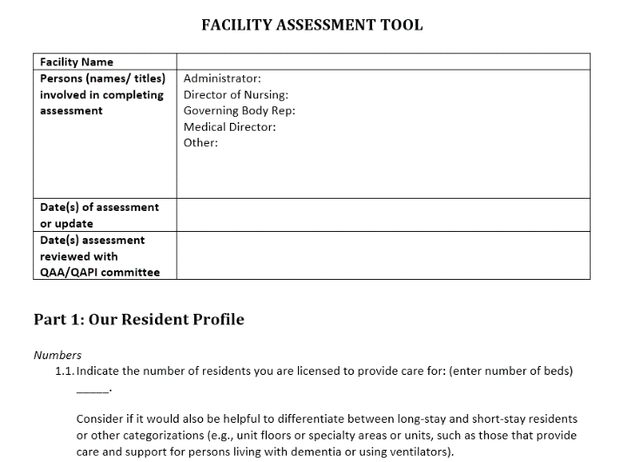
FWRA Template
Notes:
Overview of the Assessment Tool
This is an optional template provided for nursing facilities, and if used, it may be modified. Each facility has flexibility to decide the best way to comply with this requirement.
The tool is organized in three parts:
Resident profile including numbers, diseases/conditions, physical and cognitive disabilities, acuity, and ethnic/cultural/religious factors that impact care
Services and care offered based on resident needs (includes types of care your resident population requires; the focus is not to include individual level care plans in the facility assessment)
Facility resources needed to provide competent care for residents, including staff, staffing plan, staff training/education and competencies, education and training, physical environment and building needs, and other resources, including agreements with third parties, health information technology resources and systems, a facility-based and community-based risk assessment, and other information that you may choose

Slide 19
Conduct the Assessment
Assign a FWRA Leader to lead process
FWRA Leader:
Reviews regulation and interpretive guidance
Review optional tool from CMS
Identifies and invites team members
Consider and plan how to get input from residents, families, and CNAs
Consider and plan how to engage the medical director and other practitioners in the process

Slide 20

Conduct the Assessment
FWRA Leader convenes a team
Review and discuss requirements
Review process, discuss, and clarify steps needed
Establish timeline for process
Consider budgeting process with timeline
Decide how assessment will be completed
One person takes the lead on draft
Assign different people to complete different sections

Slide 21
Complete the Assessment
FWRA Leader and others evaluate and discuss different sections
Check in meeting to discuss questions or barriers
Review findings and discuss to make decisions about needed resources, staffing, capabilities, and competencies
Address day to day and emergencies

Slide 22
Incorporate QAPI
What opportunities exist for quality initiatives as a result of what we learned from the FWRA to improve our facility’s services and resources?
What findings in the FWRA indicate a need for us to collect and use additional data to inform decision making for future care and improvement?

Slide 23
Incorporate QAPI
Are there any OTHER resources that we need to care for residents competently during day to day operations or in emergencies based on the FWRA?
Has our budget been evaluated with relation to anticipated needs in the coming year, are adjustments needed in our budget to address gaps in resource needs?

Slide 24

Incorporate Infection Control
Address the Infection Control program used in the facility
Discuss the Antibiotic Stewardship component of Infection Control

Slide 25
Surveyor Questions on FWRA
How did the facility assess the resident population?
How did facility assess acuity?
How did facility determine staffing levels?
How did facility determine skill and competency requirements?
Who was involved in conducting the assessment?
How did facility determine equipment, supplies, and physical environment

Slide 26

Summary
The FWRA will need to be ready for the survey team by November 28, 2017
An investigator may request the FWRA plan so being ready with the assessment on November 28, 2017 is imperative

Slide 27

Questions?

Slide 28

Thank you for participating in this education session!

Slide 29
REFERENCES
CMS: State Operations Manual Appendix PP – Guidance to Surveyors for Long-Term Care Facilities:
https://www.cms.gov/Medicare/Provider-Enrollment-and-Certification/GuidanceforLawsAndRegulations/Downloads/Advance-Appendix-PP-Including-Phase-2-.pdf

