Slide 1


Baseline Care Plans
Notes:
This training is designed to provide facility supervisors and leaders and front line staff with an overview of the new Baseline Care Plan regulations

Slide 2

OBJECTIVES
Objective:
Understanding of the new regulation for Baseline Care Plan
Understanding the components of the Baseline Care Plan
Understanding of the Baseline Care Plan Summary
Notes:
Objectives of the education is to review RoP for Baseline Care Plans.

Slide 3

OVERVIEW
INTENT §483.21(a)
Completion and implementation of the baseline care plan within 48 hours of a resident’s admission is intended to promote continuity of care and communication among nursing home staff, increase resident safety, and safeguard against adverse events that are most likely to occur right after admission; and to ensure the resident and representative, if applicable, are informed of the initial plan for delivery of care and services by receiving a written summary of the baseline care plan.
Notes:
It is essential that a process is in place to immediately provide the individualized and necessary interventions for care of a new resident, therefore, a new regulation outlining the requirements for the 48 hour baseline care plan are outlined here today.

Slide 4
Regulation-Guidance
F655
§483.21 Comprehensive Person-Centered Care Planning §483.21(a) Baseline Care Plans §483.21(a)
(1) The facility must develop and implement a baseline care plan for each resident that includes the instructions needed to provide effective and person-centered care of the resident that meet professional standards of quality care. The baseline care plan must—

Slide 5

Regulatory Guidance
Be developed within 48 hours of a resident’s admission.
Include the minimum healthcare information necessary to properly care for a resident including, but not limited to—
  (A) Initial goals based on admission orders.
  (B) Physician orders.
  (C) Dietary orders.
  (D) Therapy services.
  (E) Social services.
  (F) PASARR recommendation, if applicable.
Notes:
It is important to look at the information from the transferring facility—usually the hospital—to determine resident care needs, level of function, mood and behaviors, special goals and treatments, dietary considerations, therapy, disease state specific concerns, medications, etc., in order to provide proper care upon admission.

Slide 6
Baseline Care Plans
Definitions
“Resident’s Goal”: The resident’s desired outcomes and preferences for admission, which guide decision making during care planning.
“Interventions”: Actions, treatments, procedures, or activities designed to meet an objective.
“Measurable”: The ability to be evaluated or quantified.
“Objective”: A statement describing the results to be achieved to meet the resident’s goals.
“Person-centered care”: means to focus on the resident as the locus of control and support the resident in making their own choices and having control over their daily lives.

Slide 7
Baseline Care Plan
Must reflect the resident’s stated goals and objectives
Include interventions that address his/her current needs
Based on admission orders
Information about the resident available from the transferring provider
Discussion with the resident and resident representative
Notes:
These are all areas that are outlined in the requirements

Slide 8

Baseline Care Plan
The care plan documents the interim approaches for meeting the resident’s immediate needs in accordance with professional standards of quality care. The care plan then must also reflect changes to approaches resulting from significant changes in condition or needs.
Notes:
The baseline care plan will provide the interdisciplinary team directions for caring for the resident—based upon current information from the transfer, MD orders and resident/representative involvement – until the comprehensive care plan is completed via the RAI process.

Slide 9
Baseline Care Plan
Facility is responsible to implement the interventions to assist the resident to achieve care plan goals and objectives.
There must be a process to communicate the interventions to the direct care staff at the time of admission and when changes occur.
(insert process)
Notes:
This slide requires each facility to document process for communication to staff on the approaches in the baseline care plan:
For example: 24 hour report, shift to shift report, morning stand-up meeting, etc.

Slide 10
Baseline Care Plan
Objective of the Baseline Care Plan Policy:
The completion and implementation of the baseline care plan within 48 hours of a resident’s admission is intended to promote:
Continuity of care and communication among nursing home staff,
Increase resident safety, and safeguard against adverse events that are most likely to occur right after admission; and
To ensure the resident and representative, if applicable, are informed of the initial plan for delivery of care and services by receiving a written summary of the baseline care plan.

Slide 11

POLICY
Baseline Care Plan Policy:
It is the policy of the facility to develop a baseline care plan within 48 hours of admission. Along with the baseline care plan is a summary of the care plan that is provided to the resident and representative, if applicable, in a language that can be understood.
Notes:
Residents/resident representatives are required to be provided with a written summary of the 48 hour care plan. This needs to be documented in the medical record. We will discuss how this will be completed in a few minutes.

Slide 12
PROCEDURE
Upon admission, the facility will begin the process of developing a baseline care plan and this care plan will be completed within 48 hours of admission.
Information for the baseline care plan will be based upon admission orders, information from the transferring provider and discussion with the resident and resident representative, if applicable.
Notes:
The key is to ensure that the facility identifies the individualized care needs of each resident—including the resident and representative to ensure the resident’s choice and care needs are addressed.

Slide 13

Procedure
Weekend admission
Off hours admission
Discussion regarding facility practice and policy
Notes:
Discuss with your team
ON off hours – it is recommended that the charge nurse caring for the resident begins the completion of the Base Line Care Plan
Place on the 24 hours communication report
Outline the 48 hour time frame
Indicated that the IDT should review and communicate and then they can add to the base line care plan as it is in development
The regulation does not indicate who is responsible rather it indicates it needs to be completed

Slide 14

PROCEDURE
The care plan will include at the minimum the following information:
  Initial goals based on admission orders
  Physician orders
  Dietary orders
  Therapy services
  Social services
  PASARR recommendations, if applicable

Slide 15

PROCEDURE
The care plan will also include at the minimum the following information:
  Instructions needed to provide effective and person-centered care that meets professional standards of quality care
  Residents immediate health and safety needs
    Prevention of decline
    Injury prevention
      Elopement
      Fall risk
      Etc.
Notes:
All directions for care and safety should be included in the 48 hour baseline care plan

Slide 16

PROCEDURE
The care plan will reflect the resident’s stated goals and objectives and include interventions that address his/her current needs.

Slide 17
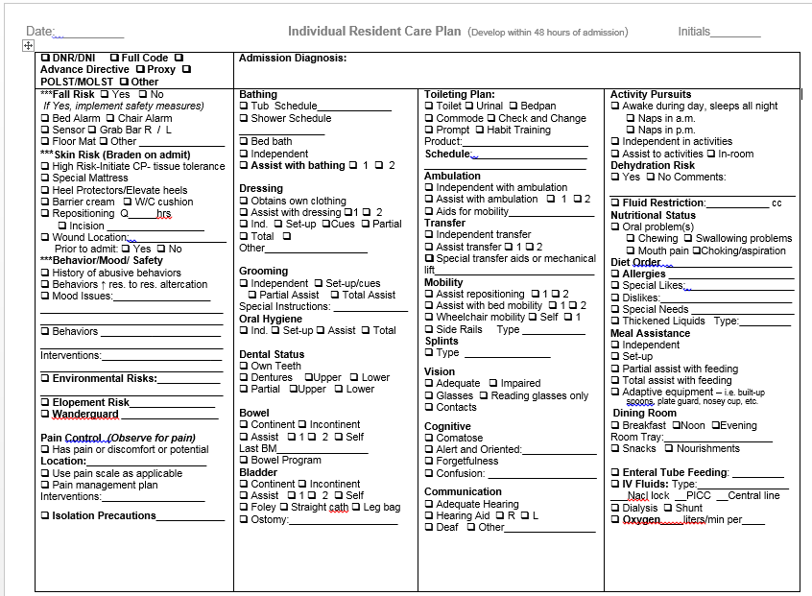
Example- Page 1 (or insert example)
Notes:
If facility will not use the attached care plan example, insert facility specific information here

Slide 18
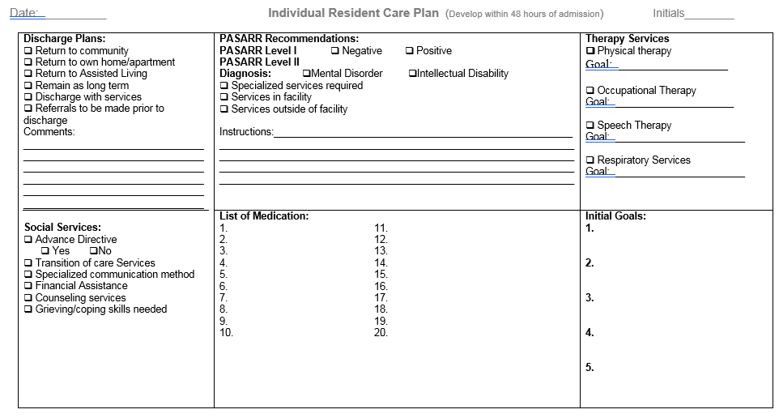
Example – Page 2 (or insert example)
Notes:
If facility will not use the attached care plan example, insert facility specific information here

Slide 19

PROCEDURE
The baseline care plan will include conditions and risks affecting the residents’ health and safety. Examples include, but are not limited to:
  Infection(s)
  Cardiac diagnoses
  Neurological Impairments
  Alterations in skin integrity
  Mood and/or Behaviors
  Comfort Care Needs
  Discharge Planning Interventions
  Etc.

Slide 20
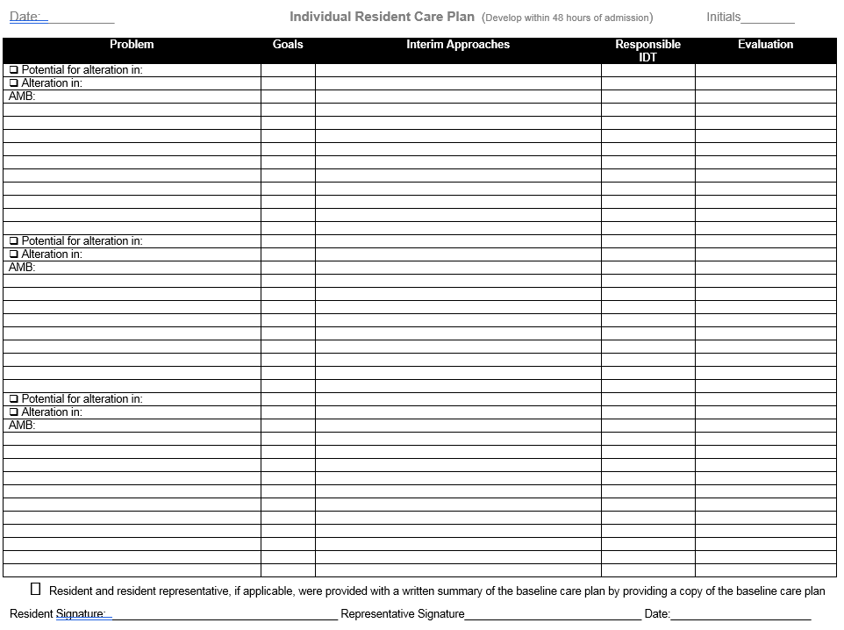
Example-Page 3 (or insert example)
Notes:
If facility will not use the attached care plan example, insert facility specific information here

Slide 21
Procedure-continued
Changes will be made to the interim approaches, as necessary, resulting from significant changes in condition or needs, occurring prior to development of the comprehensive care plan.
The facility staff or those acting on behalf of the facility will implement the interventions to assist the resident to achieve care plan goals and objectives.
Direct care staff will be educated about the care plan interventions
Notes:
Remember—staff are to be observing for any changes in resident condition. If these occur, the baseline care plan need to be revised and communication of the changes need to be made to the IDT, frontline caregivers and the resident/resident representative

Slide 22
Procedure - continued
The resident and representative, if applicable, will be provided with a written summary of the baseline care plan.
The baseline care plan summary will be in a language and conveyed in a manner the resident and representative can understand. The summary will include:
  Initial goals for the resident
  A list of current medications
  Dietary instructions
  Services (i.e. therapy) and treatments to be administered by the facility and personnel acting on behalf of the facility.
  Any updated information based on details of the admission comprehensive assessment as necessary.

Slide 23
Procedure - continued
This facility may decide to present the baseline care plan as the summary as long as it meets the requirements listed in #10.
There will be documentation in the clinical record that the baseline care plan summary was given to the resident and representative.
**See next slide
Notes:
See next slide

Slide 24
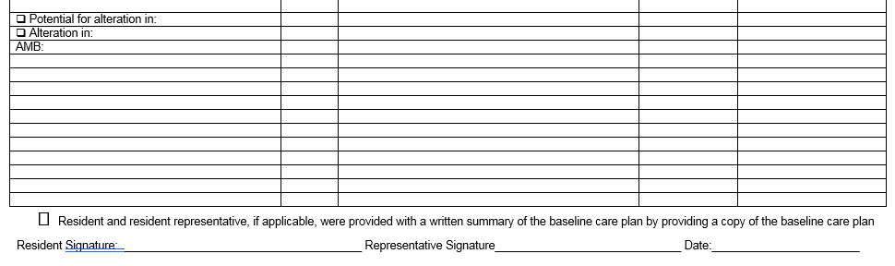
Procedure (facility specific)
At the bottom of Page 3, there is the area to show evidence of documentation that the facility provided a written summary of the baseline care plan:
Notes:
If facility will not use the attached care plan example, insert facility specific information here
At the bottom of Page 3, there is the area to show evidence of documentation that the facility provided a written summary of the baseline care plan

Slide 25
Procedure-continued
In the event that the comprehensive assessment and comprehensive care plan identify a change in the resident’s goals, or physical, mental, or psychosocial functioning, which was otherwise not identified in the baseline care plan, these changes will be incorporated into an updated summary provided to the resident and his or her representative, if applicable.
The facility has the option of completing a comprehensive care plan instead of a baseline care plan as long as the comprehensive care plan is completed within 48 hours and follows the RAI process/requirements. A written summary of the comprehensive care plan will be provided to the resident and resident representative in a language that they can understand.
Notes:
The MDS Coordinator and IDT will determine whether a comprehensive care plan will be completed in lieu of the 48 hour baseline care plan

Slide 26

Facility Response
Understand
Inform
Limitations
Monitor
Understand
Inform
Limitations
Monitor
Notes:
Our response to these updated regulations includes:
Understand – understanding the new regulations regarding the Baseline Care Plan Policy. Todays training will walked us through the changes and our roles and responsibilities.
Inform – ALL staff will be informed of new 48 hour Baseline Care Plan requirements
Limitations and Concerns – we will discuss how we handle any limitations and concerns
Monitor – we will monitor our policy via our QAPI program as applicable

Slide 27

Understand
  The interdisciplinary team will need to have a good understanding of the requirements to develop the 48 hour baseline care plan in order to communicate resident centered interventions and to provide care appropriately and safely
Notes:
The information will be developed based on the information from the transferring facility, physician orders, assessments upon admission and resident and resident representative involvement.

Slide 28

INFORM
Caregivers will be informed of resident’s assessed needs to ensure appropriate interventions
Residents/resident representatives will be informed by a written summary of the 48 hour baseline care plan
Notes:
Remember, there needs to be evidence that the resident and resident representative received a written summary of the baseline care plan to include:
Initial goals based on admission orders
Infection(s)
Cardiac diagnoses
Neurological Impairments
Alterations in skin integrity
Mood and/or Behaviors
Comfort Care Needs
Etc.
As well as:
Physician orders
Dietary orders
Therapy services
Social services
PASARR recommendations, if applicable
Instructions needed to provide effective and person-centered care that meets professional standards of quality care
Residents immediate health and safety needs
Prevention of decline
Injury prevention
Elopement
Fall risk
Etc.

Slide 29

Limitations
Knowledge: Staff not aware of the requirements
Friday, Saturday, Sunday admissions (insert facility specific process for initiation of the baseline care plan upon admission)
Staff not documenting that a written summary of the baseline care plan was provided to resident/resident representative
Notes:
Knowledge: Staff not aware of policies, appropriate procedure for baseline care plans
Friday, Saturday, Sunday admissions: Even holidays—therefore, a solid system needs to be in place to begin the 48 hour baseline care planning process upon admission (Who will start? Who will complete? Who is overseeing the process?)
Documentation of evidence: It is imperative that a written summary of the resident baseline care plan is provided to the resident/representative with DOCUMENTATION that this was provided.

Slide 30

Monitor
All caregivers will need to monitor resident for:
  Change in condition that would require a change in the baseline care plan
  Documentation of notification of the change in care plan to resident and resident representative, if applicable

Slide 31

SUMMARY
Baseline care plan must be developed and implemented within 48 hours of admission
Must include
  Initial goals based on admission orders
  Physician orders
  Dietary Orders
  Therapy services
  Social Services
  PASARR recommendations

Slide 32
Summary
Must provide the resident and representative with a summary of the baseline care plan that includes but not limited to:
Initial goals of the resident
A summary of the resident’s medications
A summary of dietary instructions
Any services and treatments to be administered by the facility
Any updated information based on the details of the comprehensive care plan, as necessary

Slide 33

Questions?

Slide 34

Thank you for participating in this education session!

Slide 35
REFERENCES
CMS: State Operations Manual Appendix PP – Guidance to Surveyors for Long-Term Care Facilities:
https://www.cms.gov/Medicare/Provider-Enrollment-and-Certification/GuidanceforLawsAndRegulations/Downloads/Advance-Appendix-PP-Including-Phase-2-.pdf

